Slide 1



Visual Studio Launch 2019 by

Slide 2
Machine Learning and Artificial Intelligence for every developer with ML.NET and Visual Studio 2019
Visual Studio 2019 Launch

Slide 3

Adrián del Rincón López
arincon@encamina.com - @adderin
Ingeniero Superior de Telecomunicaciones en la especialidad de Telemática por la UPV.
Desarrollador especializado en Bots, IA, y en general tecnologías .Net. Experiencia desarrollando aplicaciones ASP.NET y TypeScript (con React), intranets con Sharepoint durante varios años…
Actualmente trabajo en ENCAMINA con el rol de Arquitecto de software en los distintos proyectos en los que participo, sobre todo con tecnologías como Bot Framework o Databricks.

Slide 4
Just a bit of context…

Slide 5
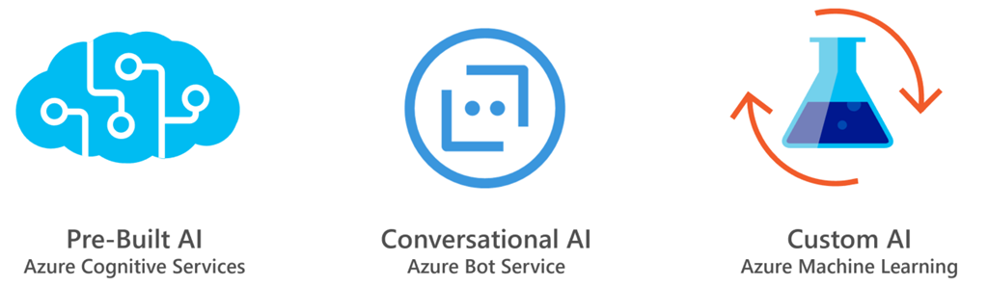
Introduction
Different type of (AI) problems → different solutions
Standar/generic problem → prebuilt AI (Cognitive Services)
Bots → Conversacional AI (Bot Framework)
Custom problema, business logic/rules, special cases/features → Custom AI

Slide 6

Custom AI
Full control of:
Process
Modeling
Infrastructure
ALM
Azure Machine Learning: Workbench, DS VM…
Azure Databricks

Slide 7
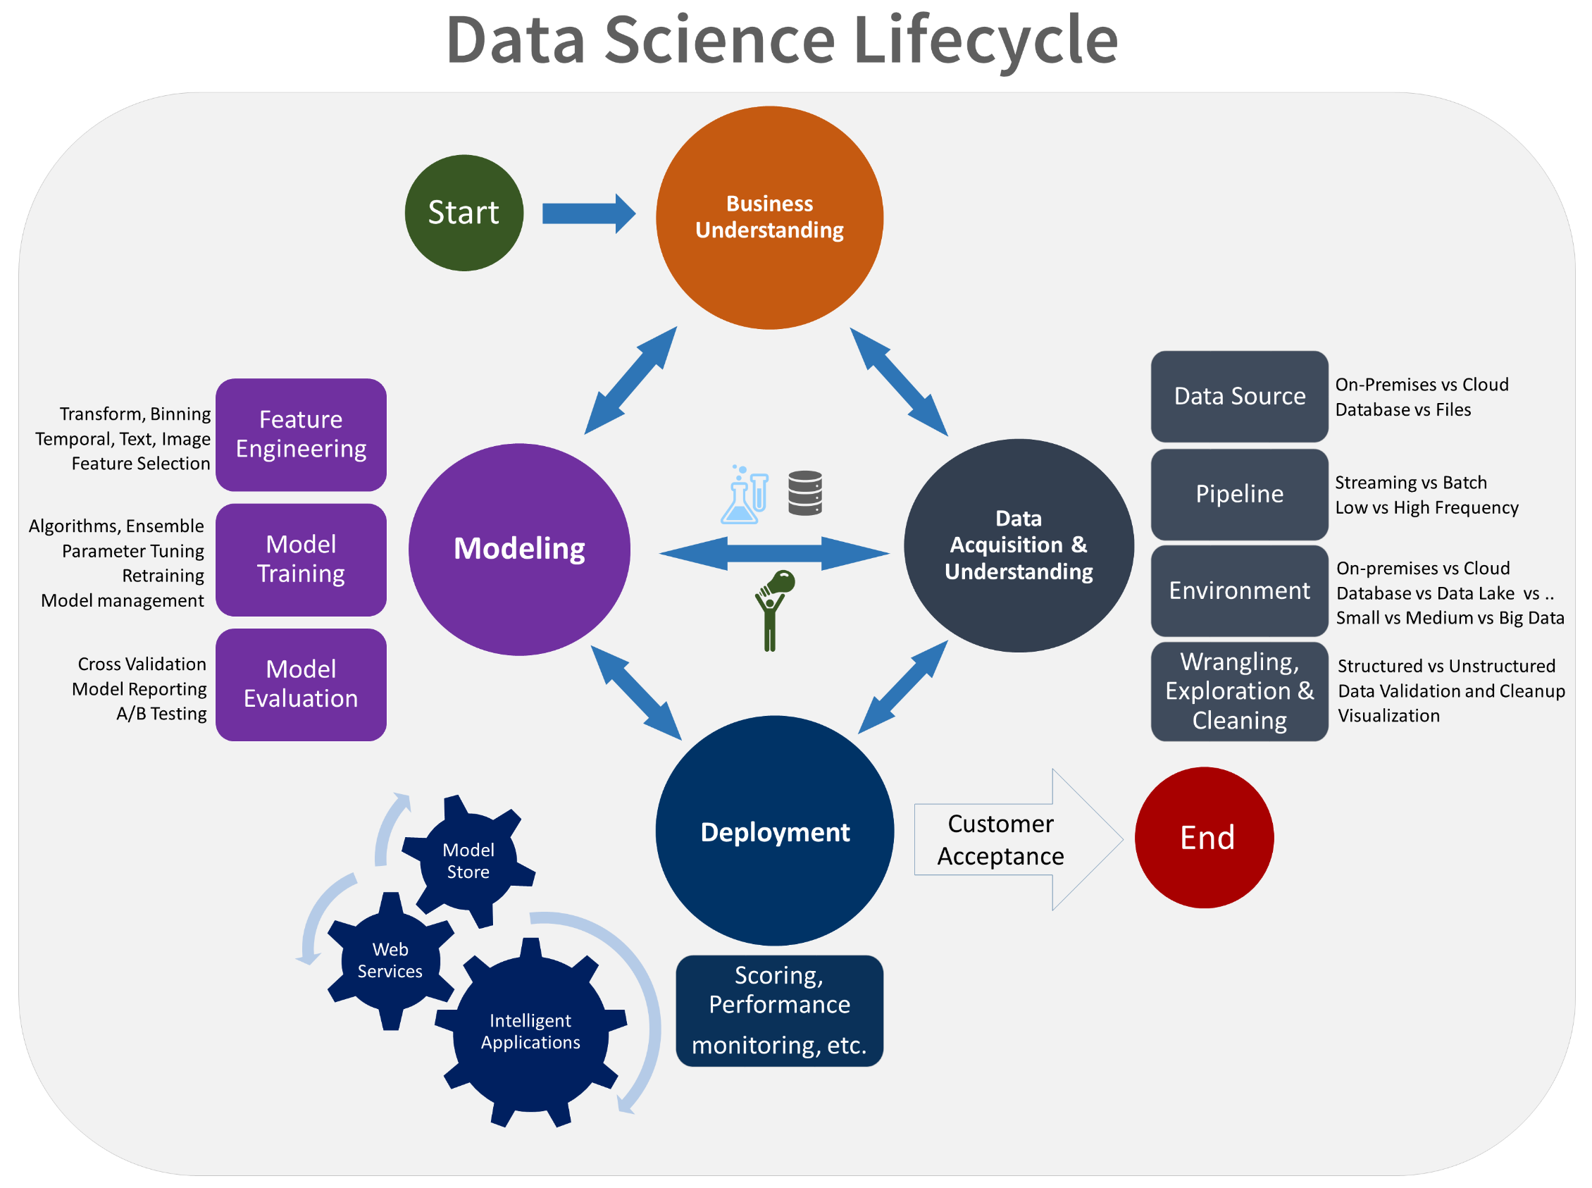
TDSP
Agile & iterative DS metodology, for inteligent apps and predictive analysis
Lifecycle
Project structure
Intrastructure & resource
Tools &utils
Iterative process, back & forth
End: customer acceptance
Notes:
BU: Descubrir las cuestiones que la organización/cliente desearía que fueran respondidas con sus datos. Esfuerzo por parte todos.
Data Acq.: Recopilas/lees los datos, normalmente de varias localizaciones. Se examina, se limpia…
Modeling: Crear experimentos con uno o más algoritmos para obtener predicciones o clasificaciones
Deployment: Desplegar nuestro model en algún sitio donde pueda ser consumido, ya sea una API, un almacenamiento de datos, Functions…

Slide 8



What is Azure Databricks ?
A fast, easy and collaborative Apache® Spark™ based analytics platform optimized for Azure
Best of Databricks
Best of Microsoft
Designed in collaboration with the founders of Apache Spark
One-click set up; streamlined workflows
Interactive workspace that enables collaboration between data scientists, data engineers, and business analysts.
Native integration with Azure services (Power BI, SQL DW, Cosmos DB, Blob Storage, ADF, SQL DB, AAD)
Enterprise-grade Azure security (Active Directory integration, compliance, enterprise-grade SLAs – 99.95%)

Slide 9
Why ML.NET?

Slide 10









Tu plataforma para crear cualquier cosa
DESKTOP
WEB
CLOUD
MOBILE
GAMING
IoT
ML
.NET
Notes:
.NET is a great tech stack for building a wide variety of applications. There is ASP.NET for web development, Xamarin for mobile development and with ML.NET we are trying to make .NET great for Machine Learning.

Slide 11




ML.NET is a machine learning framework made for .NET developers
Build your own
Proven & Extensible
Open Source & Cross platform
Developer Focused
ML.NET is available @
dot.net/ml
Notes:
So just to summarize, ML.NET is a machine learning framework made specifically targeted for .NET developers.
With ML.NET you can build custom ML models, ML.NET is used very heaving within Microsoft and starting to be adopted externally as well.

Slide 12









Machine Learning scenarios with ML.NET
Sentiment Analysis
Forecasting
Issue Classification
Predictive maintenance
Ranking news/topics
Recommendations
Image classification
Customer segmentation
And many more examples
@ https://github.com/dotnet/machinelearning-samples

Slide 13






ML.NET is proven at scale, enterprise ready (aka. TLC: MSFT internal for years)
Bing Ads (Ad Predictions)
Excel (Chart Recommendations)
Power Point (Design Ideas)
Windows 10 (Windows Defender)
Azure Stream Analytics (Anomaly Detection)
+ more
Power BI (Key Influencers)
Notes:
Even though we just recently released ML.NET at Build this year, ML.NET has been used at Microsoft heavily for over a decade by iconic MS products.
Bing Ads uses ML.NET for add-click predictions
Excel uses ML.NET for chart recommendations
PowerPoint uses ML.NET for Design Ideas
Windows10 uses ML.NET for Windows Defender

Slide 14
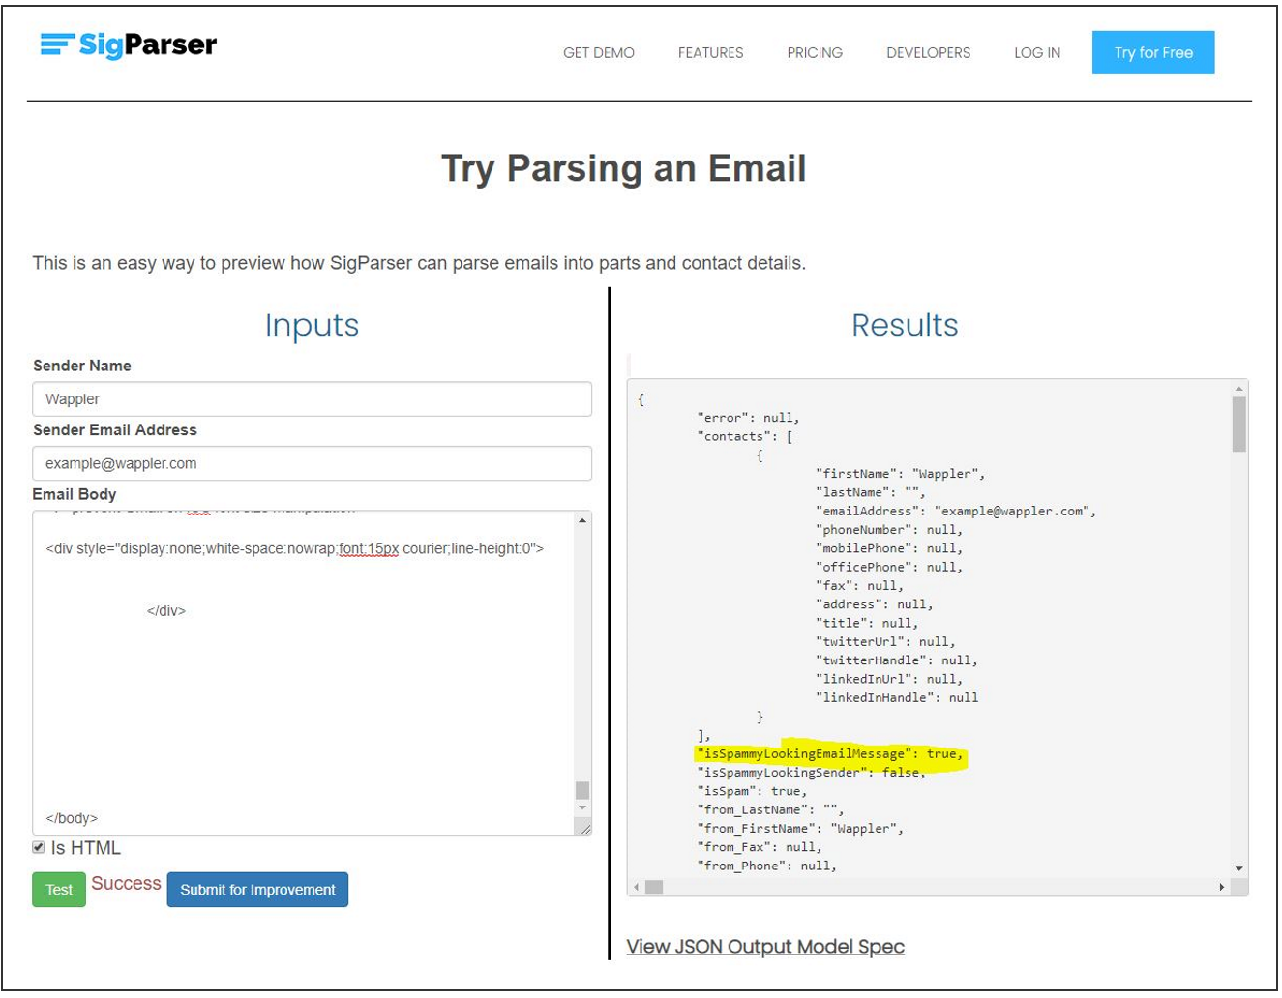
SigParser uses ML.NET
"With ML.NET, we're able to train the model and then immediately test it inside of our code. This makes shipping new changes faster because all the tooling was together in one place.“
Paul Mendoza, CEO and founder SigParser https://sigparser.com/
https://dotnet.microsoft.com/apps/machinelearning-ai/ml-dotnet/customers

Slide 15
Sentiment Analysis

Slide 16
Sentiment Analysis
Comment | Toxic? (Sentiment)
==RUDE== Dude, you are rude … | 1
== OK! == IM GOING TO VANDALIZE … | 1
I also found use of the word "humanists” confusing … | 0
Oooooh thank you Mr. DietLime … | 0
Features (input)
Label (output)
Wikipedia detox data at https://figshare.com/articles/Wikipedia_Talk_Labels_Personal_Attacks/4054689

Slide 17

Sentiment Analysis explained
Is this A or B?
Is this a toxic comment?
Yes or no

Slide 18
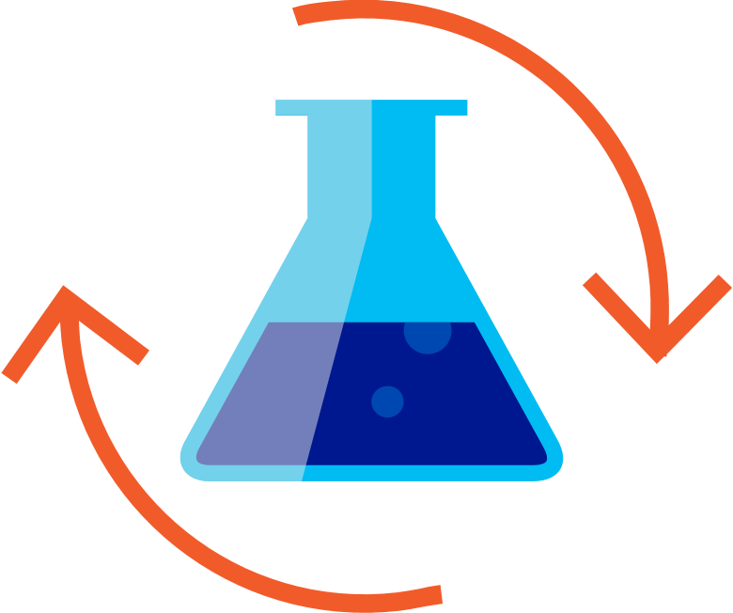

Machine Leaning workflow
Prepare Your Data
Build & Train
Run
Load Data
Extract Features
Train Model
Evaluate Model
Model Consumption

Slide 19
Image Classification

Slide 20


Deep Learning
Revolutionizing areas like computer vision and speech recognition
Takes advantage of large amounts of data and compute
Image (input)
Dog
Not a dog
Dog
Not a dog

Slide 21

Try ML.NET today!
Get started at
http://dot.net/ml
Try the samples at
http://aka.ms/mlnetsamples
Read the docs at
http://aka.ms/mlnetdocs
Request features or contribute at
http://aka.ms/mlnet
Get help for going into production
https://aka.ms/mlnetprod

Slide 22


Slide 23
Muchas Gracias
Para localizar o contactar con ENCAMINA puedes:
Envía un email a:
info@encamina.com
Puedes encontrarnos en
Ven a visitarnos:
https://www.encamina.com/donde-estamos/
O descárgate nuestra App - MyENCAMINA
Llámanos al:
962 698 064

Slide 24

Recursos de imagen

Slide 25





Recursos de imagen

Slide 26










Recursos de imagen
@
C#
</>

Slide 27
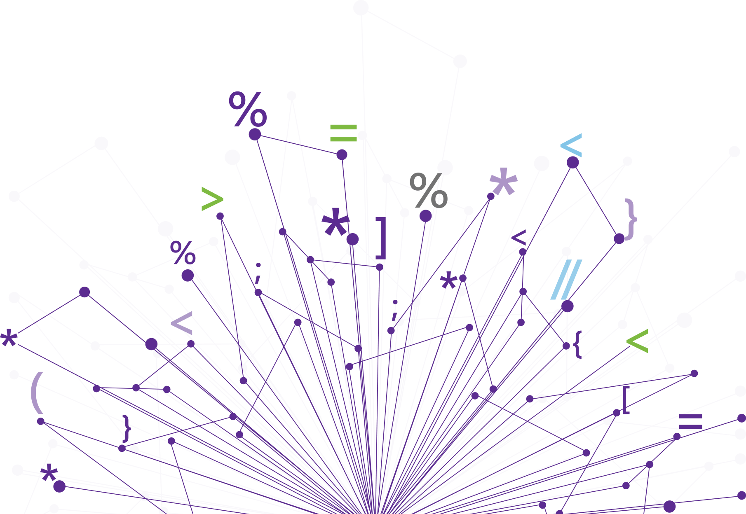


Recursos de imagen

